Slide 1
Multiple Linear Regression Multicollinearity Problem and Normality of Errors

Slide 2
Problem of Multicollinearity
Multicollinearity exists if there is strong linear relationship among the independent variables
Multicollinearity has two serious consequences:
Therefore, it is important to check for Multicollinearity in regression analysis
1. Highly Unstable Model Parameters As standard errors of their estimates are inflated
2. Model Fails to Accurately Predict for Out of Sample Data

Slide 3
Detecting Multicollinearity Through VIF
VIF (Variance Inflation Factor) Method:
Dependent Variable : Y
Independent variables : X1, X2, X3, X4
Dependent Variable | Independent Variables | R² | 1 – R² = Tolerance | VIF = 1/(Tolerance)
X1 | X2, X3, X4
X2 | X1, X3, X4
X3 | X1, X2, X4
X4 | X1, X2, X3
Any VIF > 5, indicates presence of Multicollinearity

Slide 4
Detecting Multicollinearity in R
#Importing the Data, Fitting Linear Model
perindex<-read.csv("Performance Index.csv", header=TRUE) jpimodel<-lm(jpi~aptitude+tol+technical+general, data=perindex)
#Variance Inflation Factor
#Install and load package “car”.
install.packages("car") library(car) vif(jpimodel)
car stands for Companion to Applied Regression and consists of several useful functions for advance regression analysis.
vif() in package car calculates VIFs.
*
Continuing with same dataset “Performance Index”

Slide 5
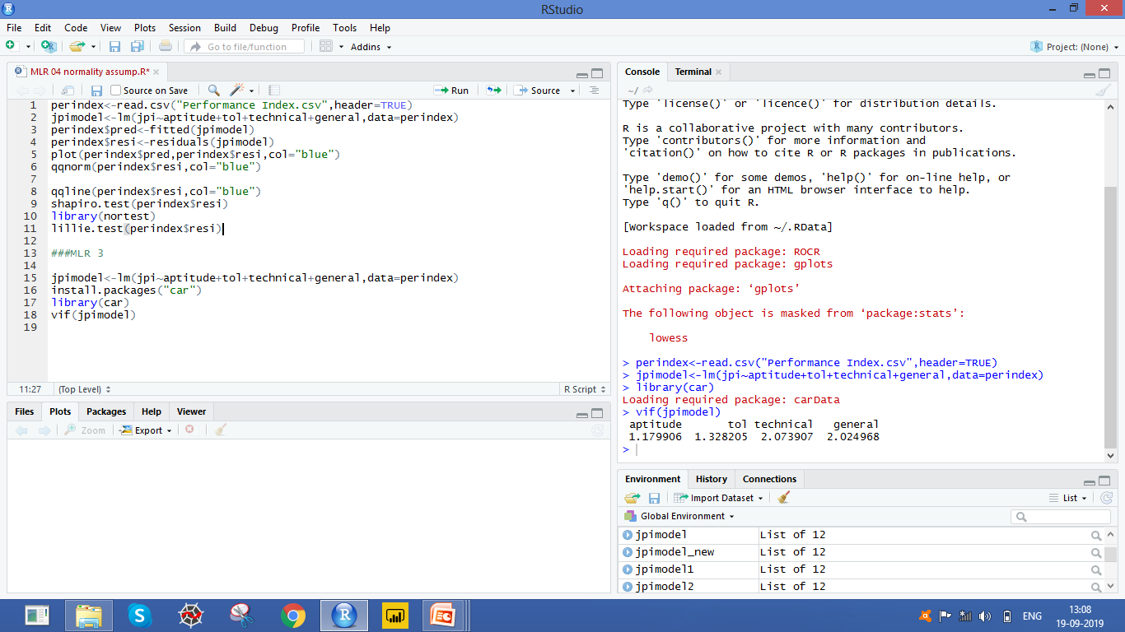
Detecting Multicollinearity in R
# Output
Interpretation :
All VIFs are less than 5, Multicollinearity is not present.

Slide 6
Multicollinearity – Remedial Measures
The problem of Multicollinearity can be solved by different approaches:
Drop one of the independent variables, which is explained by others
Use Principal Component Regression in case of severe Multicollinearity
Use Ridge Regression
*
Dropping a variable may not be a good idea if many VIFs are large.
Principal Component Method will be discussed in detail under Data Reduction and Segmentation

Slide 7
Case Study - Modelling Resale Price of Cars
Background
A car garage has old cars for resale. They keep records for different models of cars and their specifications.
Objective
To predict the resale price based on the information available about the engine size, horse power, weight and years of use of the cars
Available Information
Records -26
Independent Variables: ENGINE SIZE, HORSE POWER, WEIGHT AND YEARS
Dependent Variable: RESALE PRICE

Slide 8
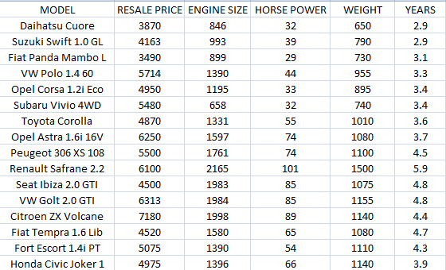
Data Snapshot
Dependent variable
Independent variables
Columns | Description | Type | Measurement | Possible values
MODEL | Model of the car | character | - | -
RESALE PRICE | Resale price | numeric | Euro | positive values
ENGINE SIZE | Size of the engine | numeric | cc | positive values
HORSE POWER | Power of the engine | numeric | kW | positive values
WEIGHT | Weight of the car | numeric | kg | positive values
YEARS | Number of years in use | numeric | - | positive values
Observations

Slide 9
Correlation Matrix
# Importing the Data
cardata<-read.csv(”car price data.csv", header=TRUE)
# Graphical representation of data
# Install and load package “GGally”
install.packages("GGally") library(GGally) ggpairs(cardata[,c("RESALE.PRICE","ENGINE.SIZE","HORSE.POWER","YEARS")],title="Scatter Plot Matrix", columnLabels = c("RESALE.PRICE", "ENGINE.SIZE","HORSE.POWER","YEARS"))
ggpairs() in the package GGally is used to plot the scatter plot matrix.

Slide 10
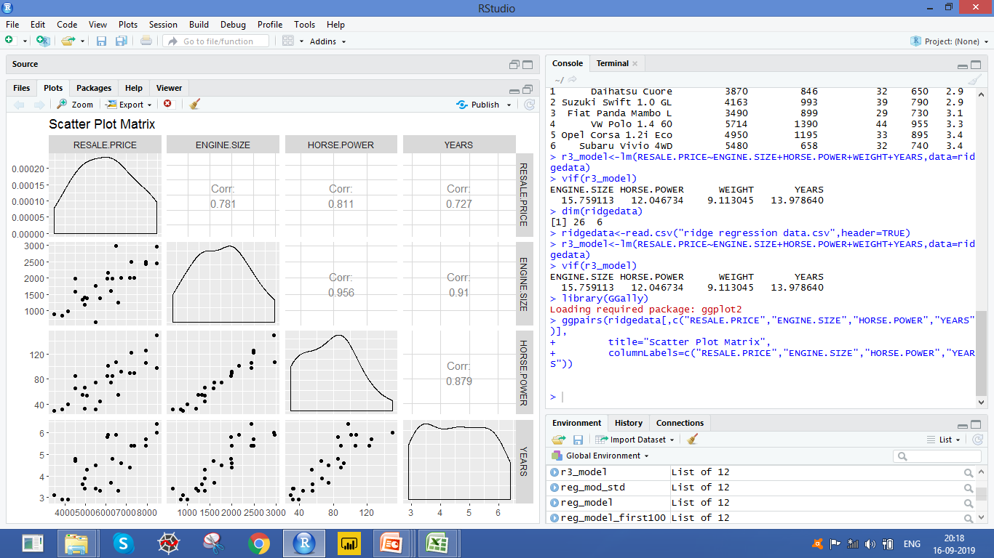
Correlation Matrix
# Output
Interpretation :
The independent variables have high positive correlation among themselves .

Slide 11
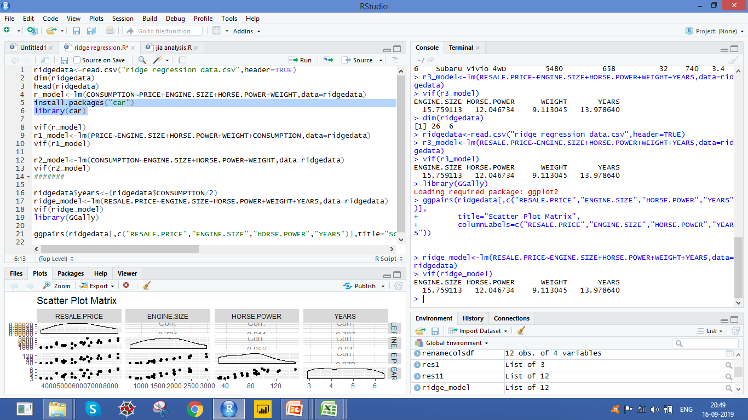
Detecting Multicollinearity in R
#Fitting Linear Model
model<-lm(RESALE.PRICE ~ ENGINE.SIZE +HORSE.POWER +WEIGHT+ YEARS, data=cardata)
#Variance Inflation Factor
library(car) vif(model)
# Output
Interpretation
VIF values for all the variables are greater than 5, hence we can conclude that there exist Multicollinearity between the independent variables.

Slide 12
Normality of Errors
The errors in Multiple Linear Regression are assumed to follow Normal Distribution.
If Normality of Errors is not true then statistical tests and associated P values based on F and t distribution are not reliable.

Slide 13
Residual Analysis
Observed Value – Predicted value = Residual
Residuals v/s Predicted Plot
Checks randomness of errors
Quantile-Quantile Plot
Residual Analysis
Shapiro Wilk Test
Checks distribution of errors
Kolmogorov-Smirnov (KS) Test

Slide 14
Residual Analysis for Performance Index Data
Continuing with the “Performance Index “ data,
Model job performance index ( jpi ) based on aptitude score ( aptitude ), test
of language ( tol ), technical knowledge ( technical ) and general information
( general )
Get the fitted values and thus the residuals.
Analyse the distribution of residuals

Slide 15
Residual v/s Predicted Plot in R
#Importing the Data, Fitting Linear Model and Calculate Fitted Values and Residuals
perindex<-read.csv("Performance Index.csv",header=TRUE) jpimodel<-lm(jpi~aptitude+tol+technical+general, data=perindex) perindex$pred<-fitted(jpimodel) perindex$resi<-residuals(jpimodel)
lm() fits a linear regression.
fitted() and residuals() fetch fitted values and residuals respectively.
#Residuals v/s Predicted Plot
plot(perindex$pred,perindex$resi,col="blue")
plot() is used to plot predicted values against residuals.

Slide 16
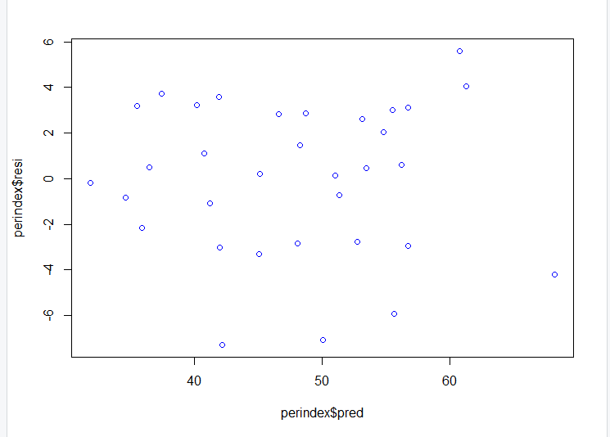
Residual v/s Predicted Plot in R
# Output
Interpretation:
Residuals in our model are randomly distributed which indicates presence of Homoscedasticity

Slide 17
QQ Plot in R
The Quantile-Quantile (QQ) Plot is a powerful graphical tool for assessing normality.
Quantiles are calculated using sample data and plotted against expected quantiles under Normal distribution.
If the data are truly sampled from a Gaussian (Normal) distribution, the QQ plot will be linear.
High Correlation between Sample Quantiles and Theoretical Quantiles
Normality

Slide 18
QQ Plot in R
#QQ Plot
qqnorm(perindex$resi,col="blue") qqline(perindex$resi,col="blue")
qqnorm() produces a plot with theoretical quantiles on x axis against the sample quantiles on y axis.
Column for which normality is being tested is specified in the first argument.
qqline() adds a line which passes through the first and third quartiles.

Slide 19
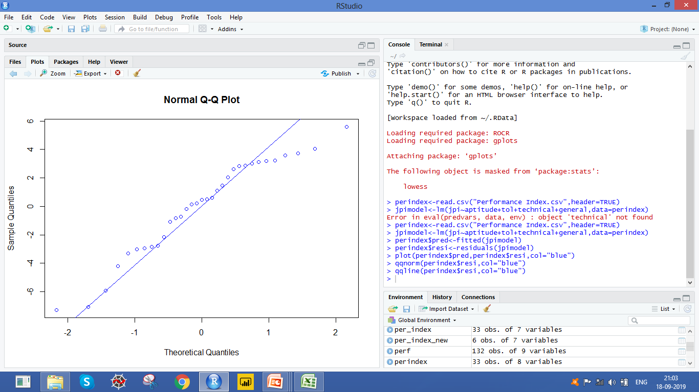
QQ Plot in R
# Output
Interpretation:
Most of these points are close to the line except few values indicating no serious deviation from Normality.

Slide 20

Absence of Normality – Remedial Measure
Mathematical Transformation of the dependent variable is used as a remedial measure in case of serious departure from Normality.
Typically Log Transformation is used. However, there is general transformation called as Box Cox Transformation given as :
Box Cox transformation
R can automatically detect the optimum λ using boxcox() in package MASS
Where Y is the response variable

